Slide 1

BROCOMMENDER
Robin DEBESSEL
An attempt at indicating what you should play next without the visual and emotional hassle !

Slide 2
Table of contents
01
02
03
04
Vision & Usecase
Data Sources & Data collecting
Overall Process of my first idea
Data cleaning, EDA, Visualization

Slide 3
Table of contents
05
06
07
08
SQL
Machine Learning
Conclusion
Demo time !

Slide 4
1 - Vision & Use case

Slide 5
What ? How? “The way of it”
"Brocommender" : a recommendation algorithm based on a user’s Steam ID
What’s a Steam ID ? But mainly, what is Steam ?
Generating a short list of game recommendations that aligns with the games that a user has spent a lot of time playing

Slide 6
Why? – The motivations “The sake of it”
Intended to be personalized
Leading to higher likelihood of discovering new games they would enjoy
Key reasons to use Brocommender:
Might have missed
Lost track of
Respecting a user’s genuine motivations

Slide 7
Why? – The ethics “The core of it”
“Trapped” through unwanted redirections or plain manipulation
Tailored for our satisfaction but also accompanied by an ever present incentive : being the most profitable
Through a minimalist and unoppressive interface that doesn’t contain hundreds of references on one page, displayed for commercial purpose
Be interactive enough to keep engagement with the user while getting rid of the things they did not ask to see to stay on track

Slide 8
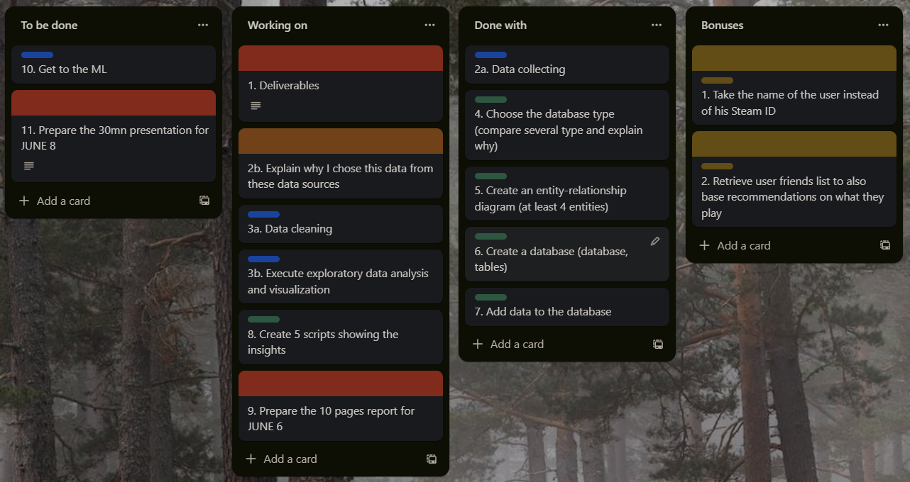
Why? – The ethics “The core of it”
“Trapped” through unwanted redirections or plain manipulation
Tailored for our satisfaction but also accompanied by an ever present incentive : being the most profitable.
Through a minimalist and unoppressive interface that doesn’t contain hundreds of references on one page, displayed for commercial purpose
Be interactive enough to keep engagement with the user while getting rid of the things they did not ask to see to stay on trackc
Snapshot taken Tuesday the 6th around 12:30pm

Slide 9
2 - Data Sources & Data Collecting

Slide 10
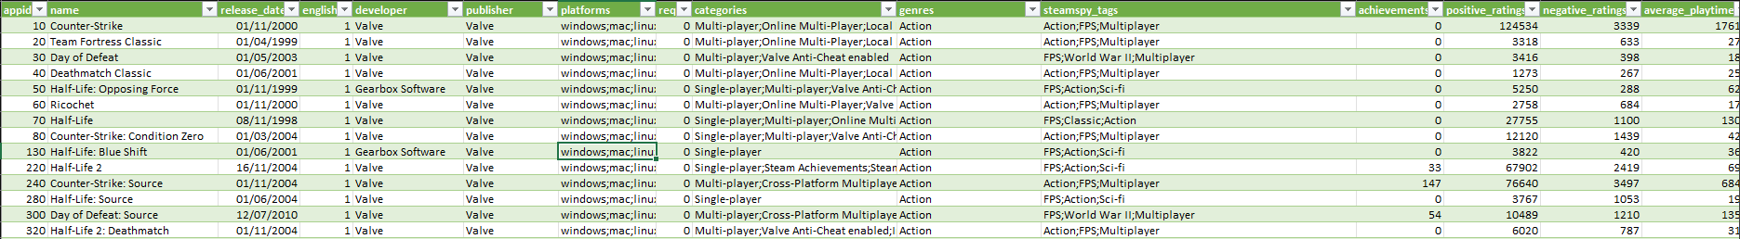
Data Sources - 1
The primary data source for the project was a dataset downloaded from Kaggle, a well-known online community of data scientists and machine learning practitioners.
The dataset, although four years old, provides a comprehensive snapshot of various game features, which is crucial for the project.
The main attributes considered from the data include the game's genre, the amount of time played, and user ratings. This dataset is 27000+ rows long and has 18 different columns. For now !

Slide 11
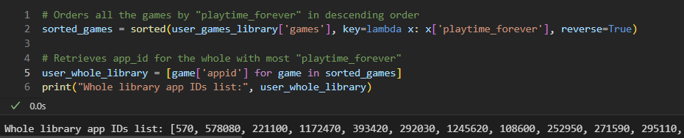
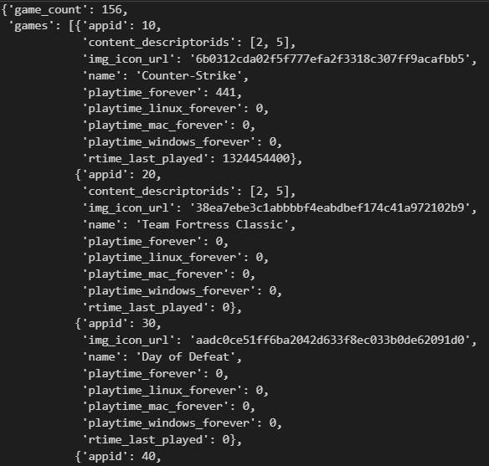
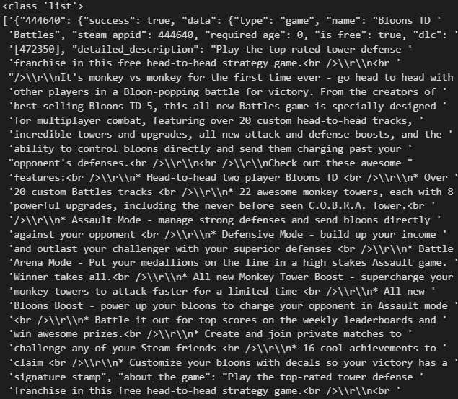
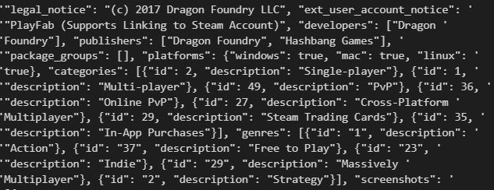
Data Sources - 2
The second data source we are going to use is the user’s Steam games library. This will be taken care of using the Steam API to dynamically retrieve a user’s account information in order for us to gather the required data.

Slide 12
3 - Overall Process of my first idea

Slide 13
Early process
"Brocommender" was originally organized into three separate notebooks, each serving a distinct purpose for safety and clarity measures.
Getting user’s data
Data cleaning, analysis and exporting operations
Machine Learning operations
We ended up into two notebooks only following a turning point
Data cleaning, analysis and exporting operations
Getting user’s data + Machine Learning Operations

Slide 14
Early challenges
Use of the Steam API wrapper for Python New concept, I misunderstood it to be the API itself, which led to a few obstacles, during the implementation process.
Pros : It provided a simple and efficient way to gather essential data elements necessary for our algorithm without having to collect all the data manually from the Steam platform through their basic API, which would have been less practical and much more time consuming.
Cons : Far from being ‘complete’ compared to the original API
Managing the complex data structure that the game genres and other crucial info were embedded in
Extracting them proved to be a tedious task that took numerous hours.

Slide 15
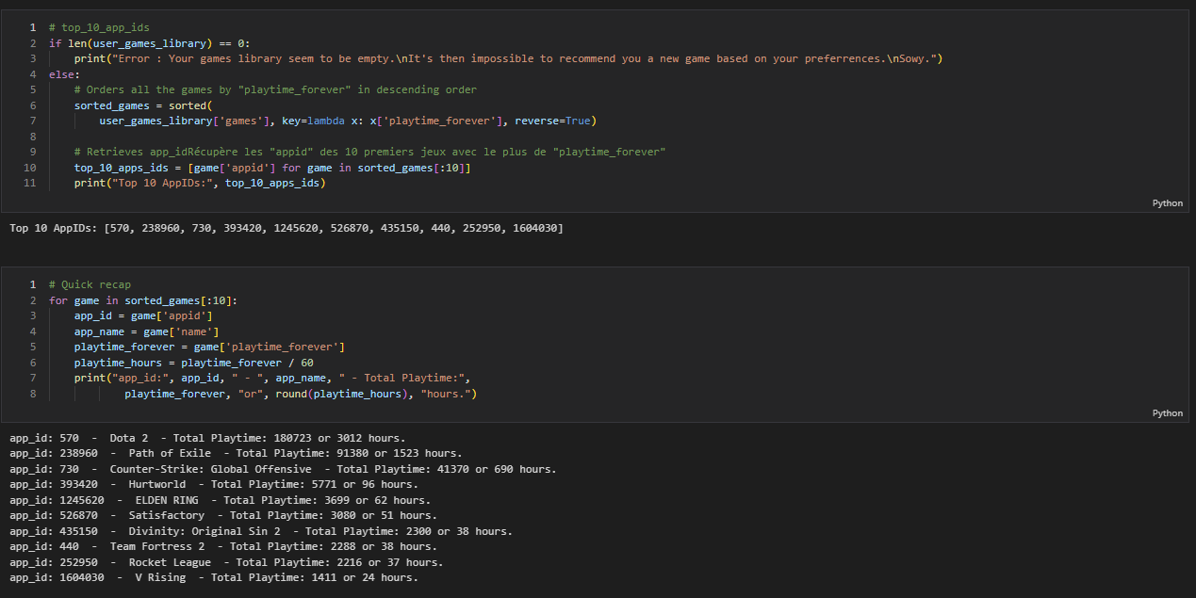
Early process

Slide 16
“An epiphany”
Knowing the steamspy_tags were ‘THE’ thing from the beginning I was quite frustrated not being able to get them
June the 6th @ 12:30pm : “Gathering the game genres from the Steam ID is not relevant for a good recommender. As I can’t retrieve steamspy_tags on my end, the dataset is much more complete than my poor requests results.”
For this version of Brocommender, as our dataset is not dynamically fetched or scaled (4+ years old!), it seems obvious it’s the way we should go.
We can always keep our original idea for eventual future versions !
New plan : - Get all the games of a user’s library. - Get the corresponding apps_ids - Compare the apps_ids values and see if they are in our dataset - Recommend up to 3 games for the user’s 3 most played games

Slide 17
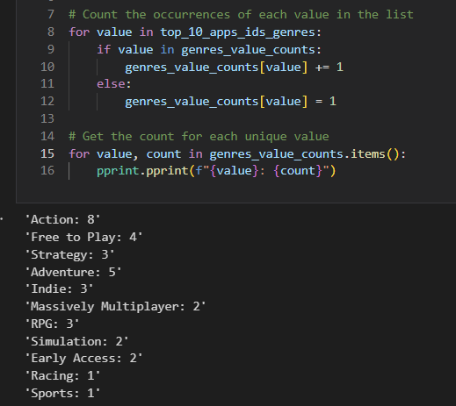
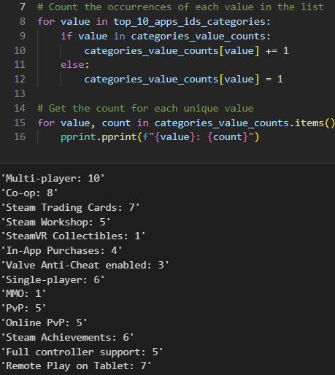
“Dropping it”
This breakdown was then refined into a Top 3

Slide 18
4 - Data cleaning, EDA, Visualization

Slide 19
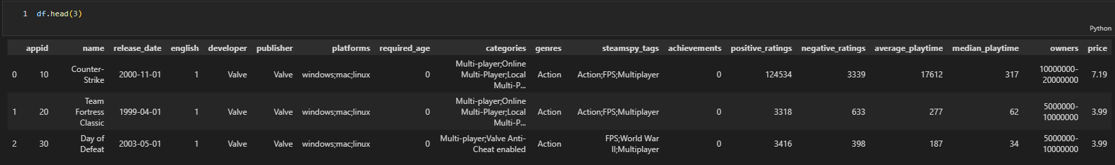
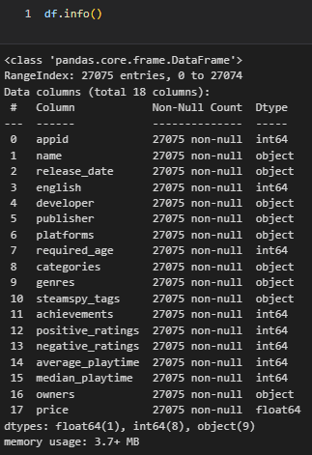
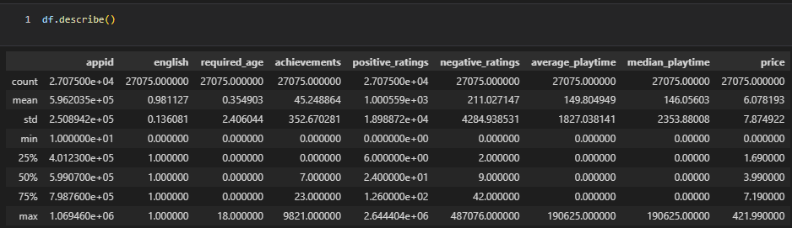
“Is it clean enough?” - 1

Slide 20
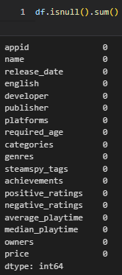
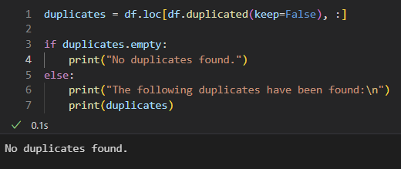
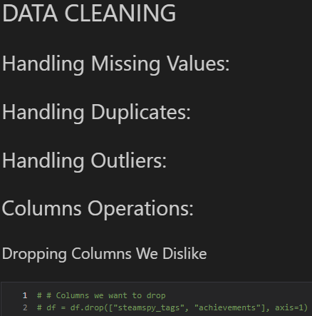
“Is it clean enough?” - 2

Slide 21
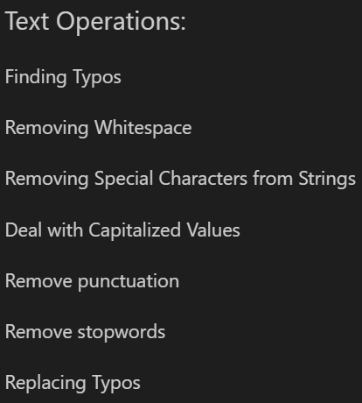
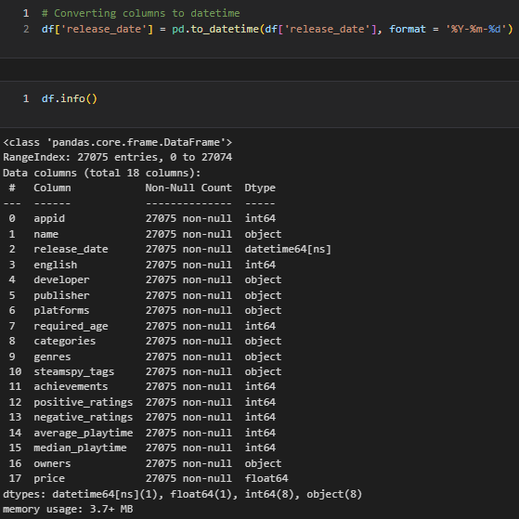
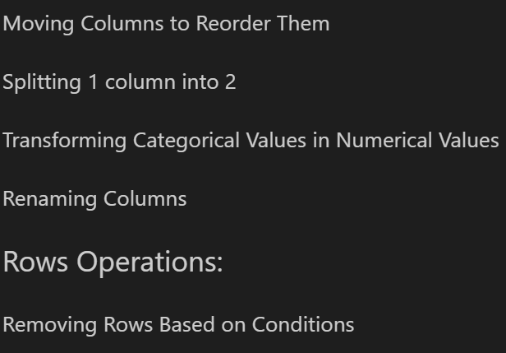
“Is it clean enough?” - 3
Yes, it really is.

Slide 22
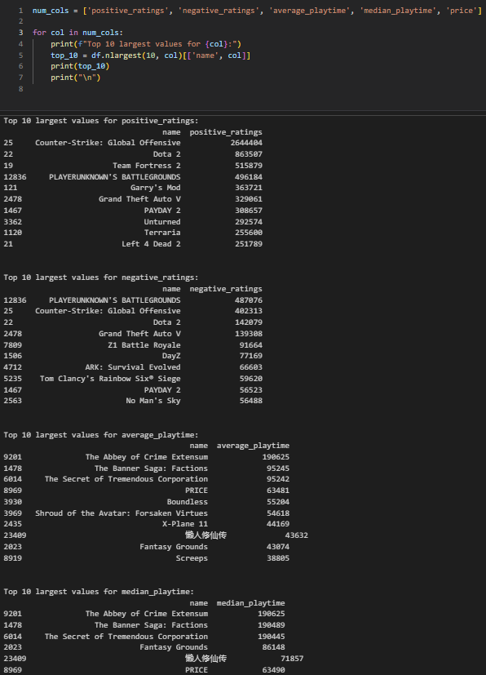
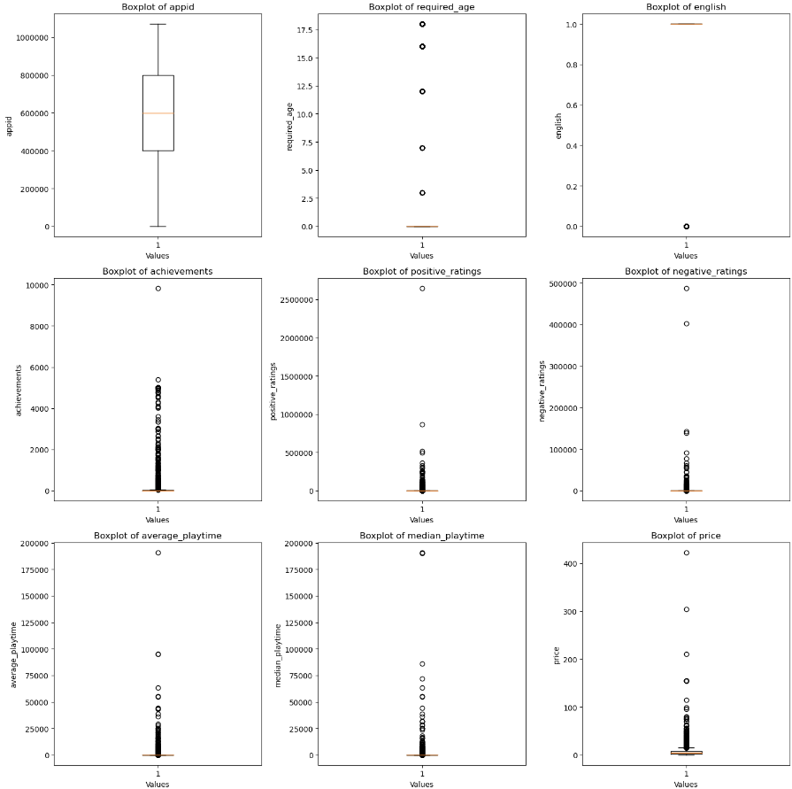
“So, what about it then ?” - 1
An effective combo if there’s one!

Slide 23
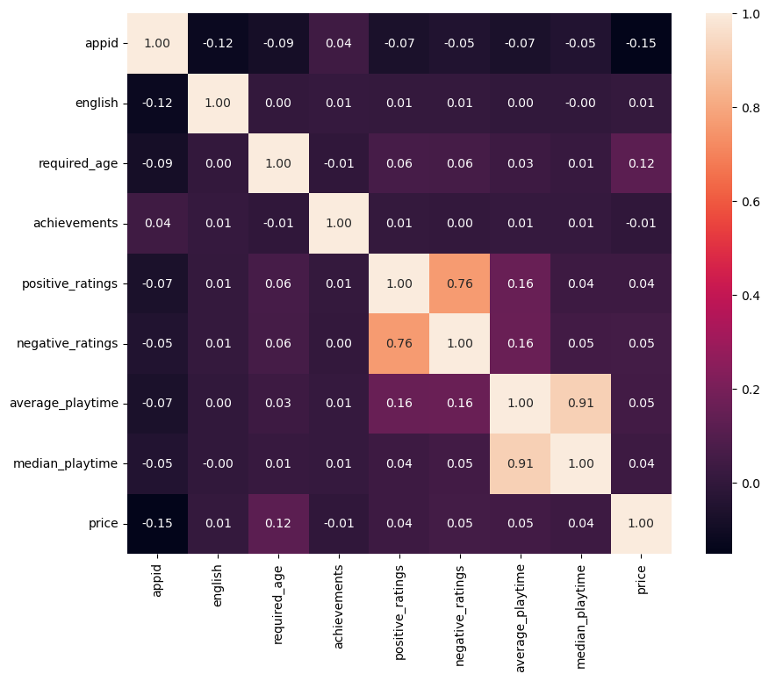
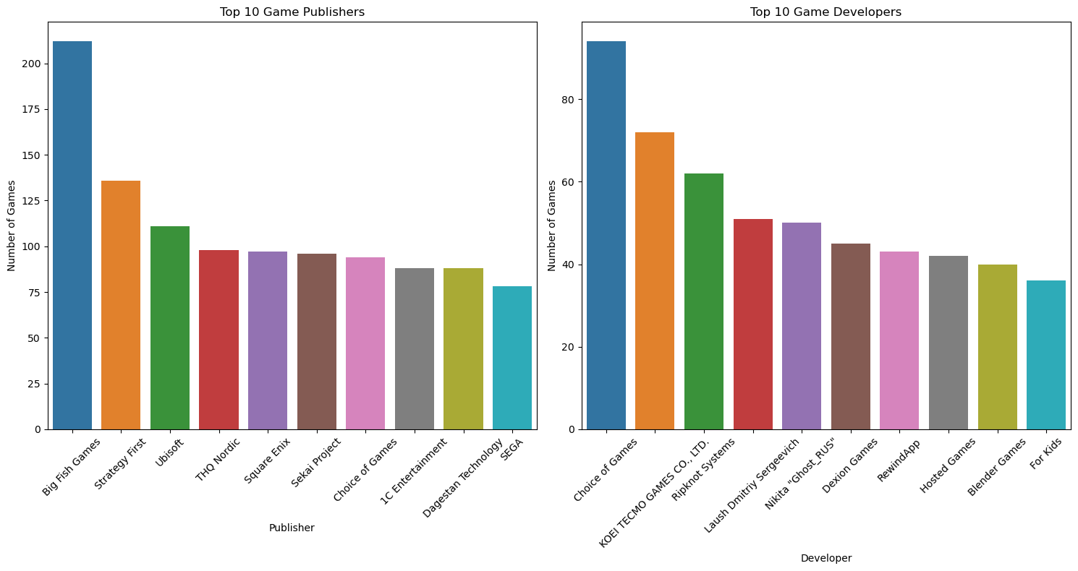
“So, what about it then ?” - 2
Yes, it really is.

Slide 24
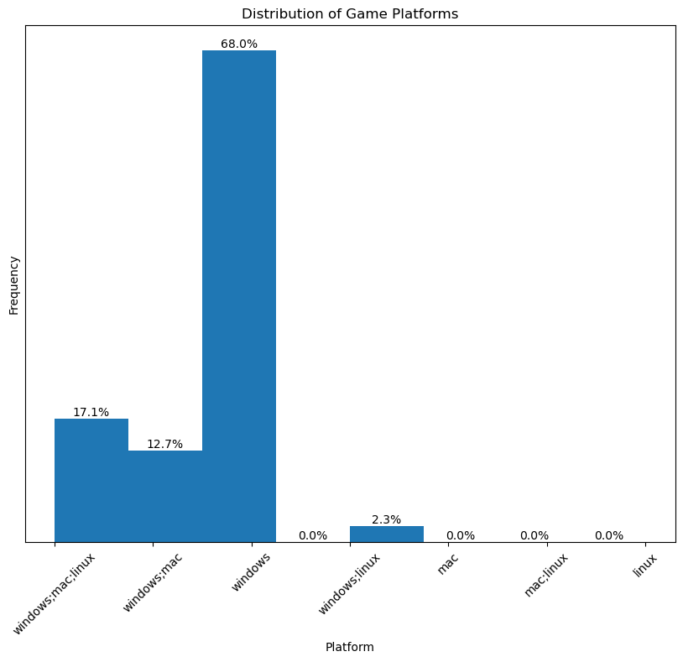
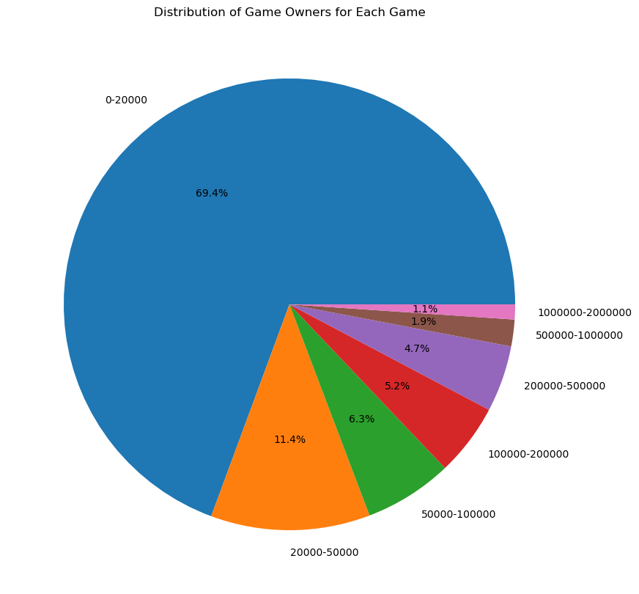
“So, what about it then ?” - 3

Slide 25
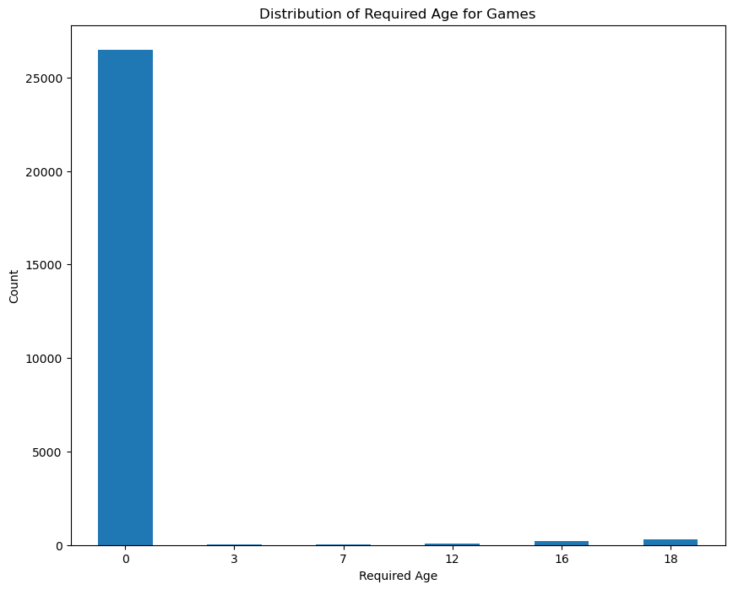
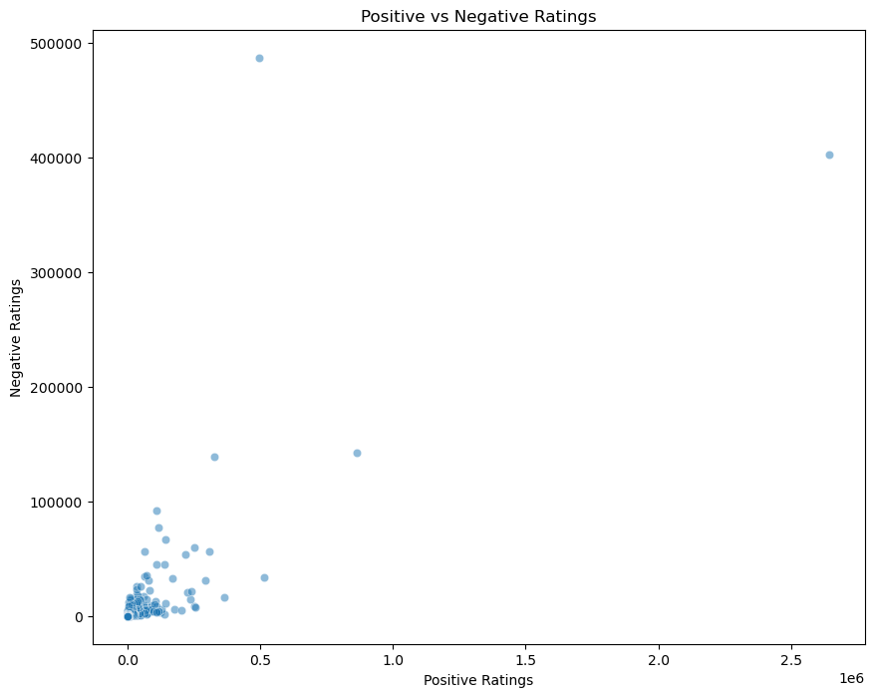
“So, what about it then ? - 4

Slide 26
5 - SQL

Slide 27
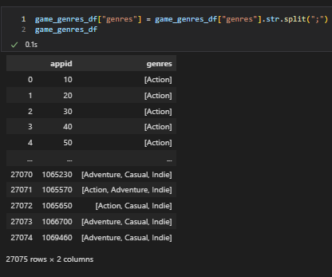
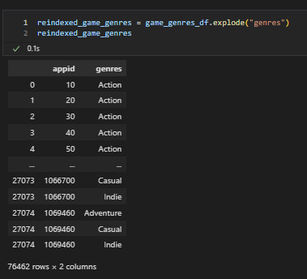
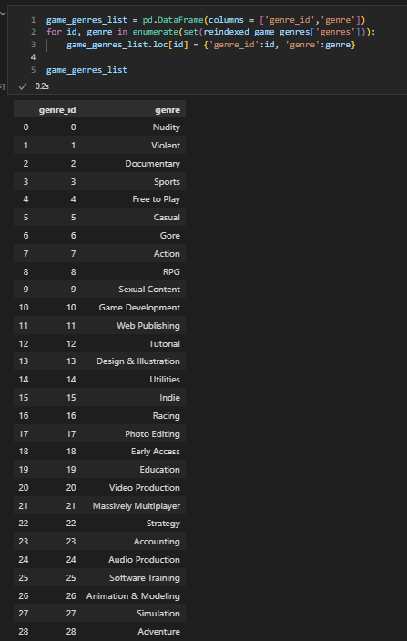
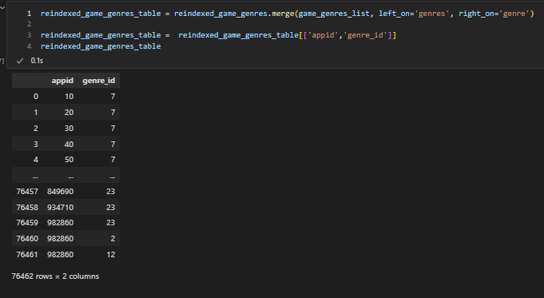
SQL - Preparing Tables Export

Slide 28
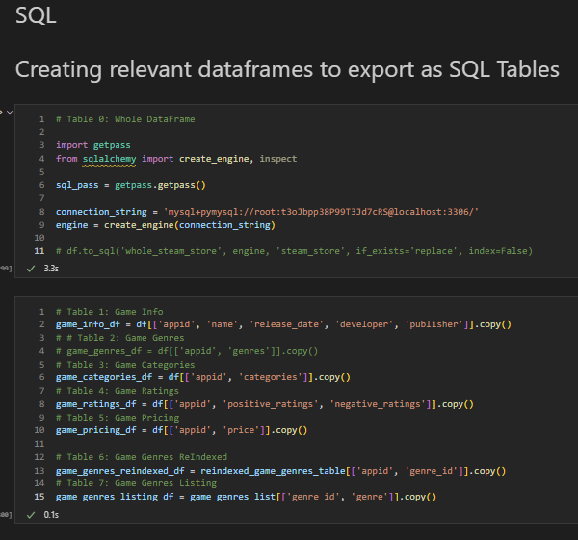
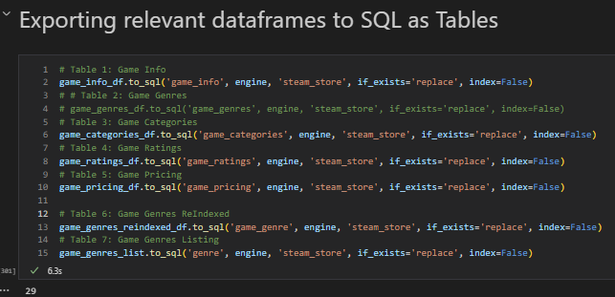
SQL - Tables Export

Slide 29
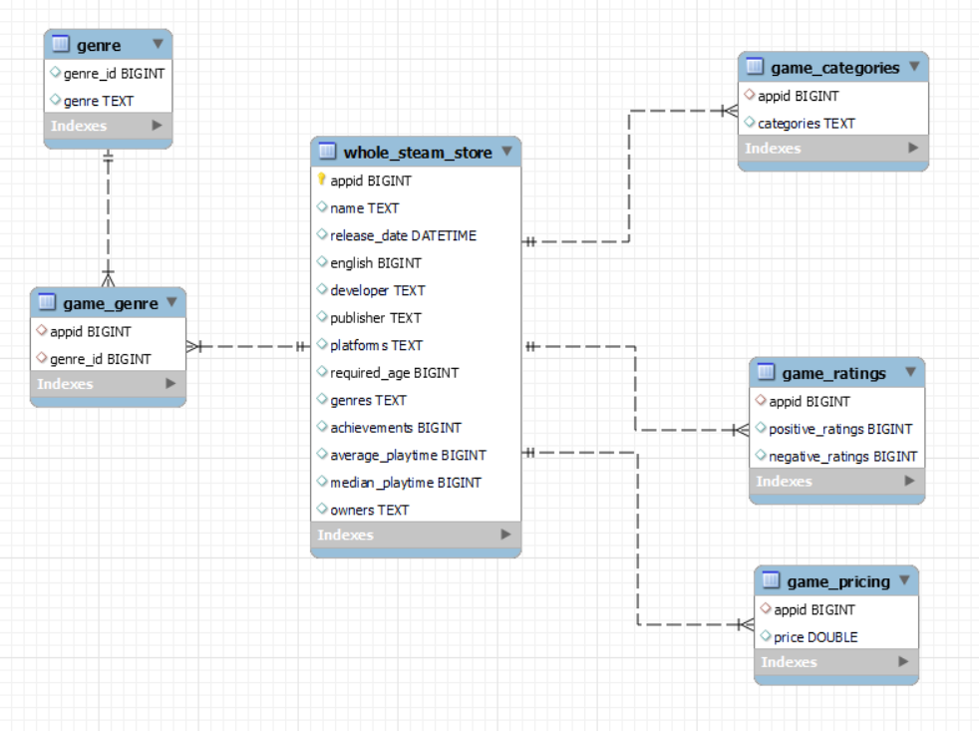
SQL - ERD

Slide 30
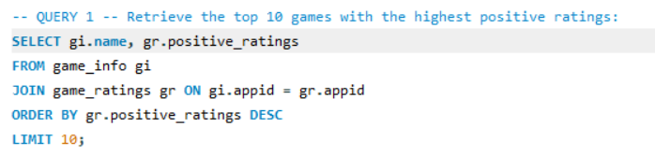
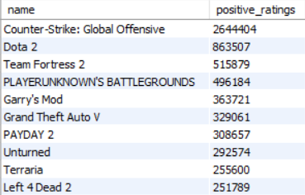
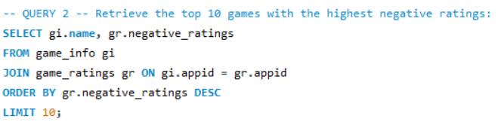
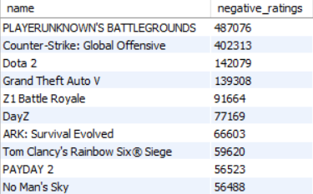
SQL – Queries - 1

Slide 31
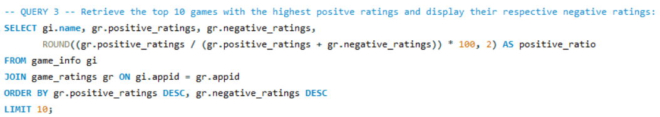
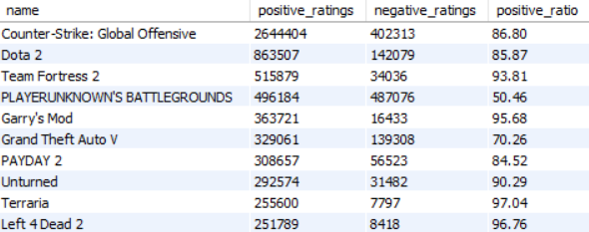
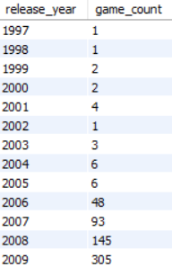
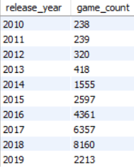
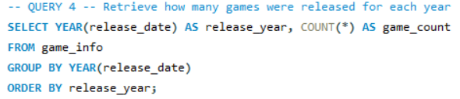
SQL – Queries - 2

Slide 32
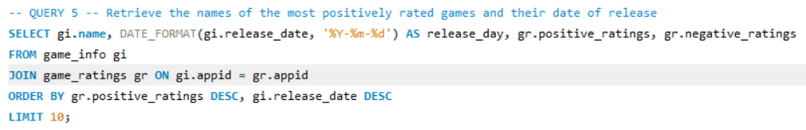
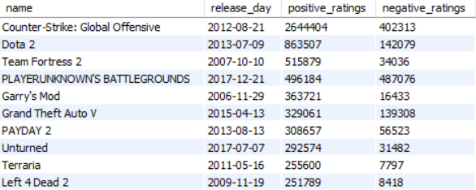
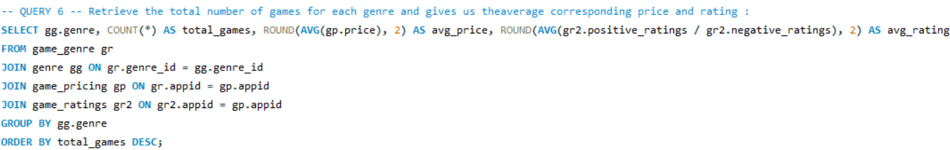
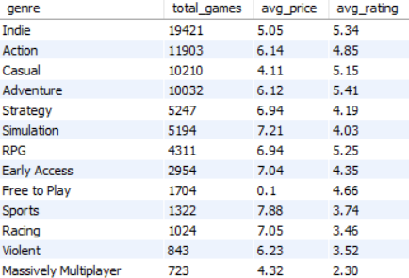
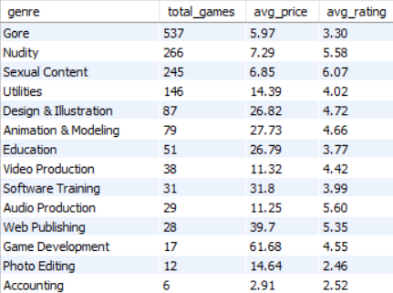
SQL – Queries - 3

Slide 33
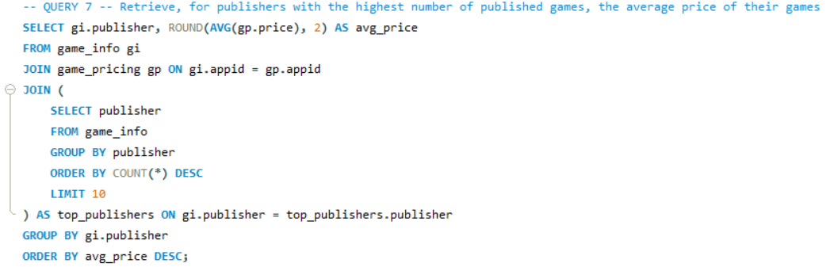
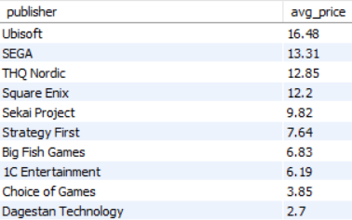
SQL – Queries - 4

Slide 34
6 - Machine Learning

Slide 35
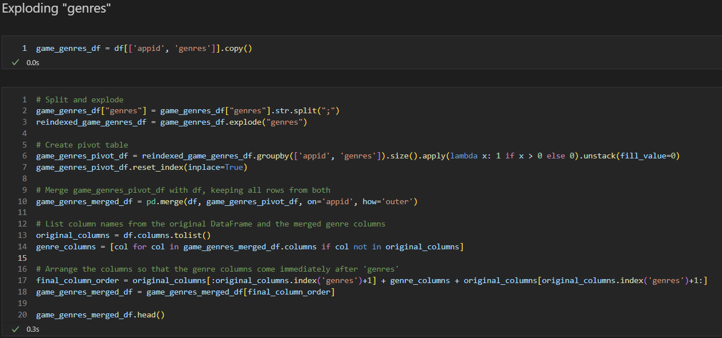

ML Prep – Exploding genres

Slide 36


ML Prep – Exploding steamspy_tags

Slide 37

ML Prep – Dropping cat. columns

Slide 38

ML Prep – Scaling with SS

Slide 39

ML Prep – Scaling with MMS

Slide 40


Machine Learning - PCA

Slide 41


Machine Learning – Elbow 1

Slide 42


Machine Learning – Elbow 2

Slide 43


Machine Learning – Kmeans clustering

Slide 44


Machine Learning – Plotting

Slide 45

Machine Learning – the final DataFrame

Slide 46
7 - Conclusion

Slide 47
Conclusion
The journey to creating "Brocommender" in only a few days time has been filled with great learning opportunities
Discovering / overcoming new technical concepts – API Wrappers
Getting a better understanding of concepts learnt during my formation like data scaling, PCA or clustering
This is just the beginning ! The magic of coding and computer science residing mostly in automation and constant improvement, version after version.
I really hope and want to finalize the recommender and make it somehow useful, if not only to me, to anybody willing to try it

Slide 48
8 - Demo Time !

Slide 49
Thank you kindly !
Any questions ?!

